Slide 1
Overview slides
October 2023
Notes:
There are 4 variations of the title page created in the Master Slides. To choose another option right click on the slide > Layout > and choose your desired design
To change the background image: Right click on the background image > Format Background > Fill > Picture or texture fill > Picture source > Insert > From a file (or online) > select you image and press Open.

Slide 2


Datasets
Hosted portals
90,213
15
Country Participants
64
Peer-review papers
using data
9,356
Organizational Participants
Average records
downloaded per month (2023)
43
161.8 billion
Species
occurrence records
Publishers
2,129
2,580,453,216
By the numbers | 2 October 2023
www.gbif.org
Notes:
Frequently used slide, redone
Please copy and paste these to your slides and never make any changes to them directly in the toolkit.
Useful to see GBIF in its different modalities:
A window on biodiversity
An informatics infrastructure focuseD on tools and standards in service to science and society
A global network on bioinformatics

Slide 3
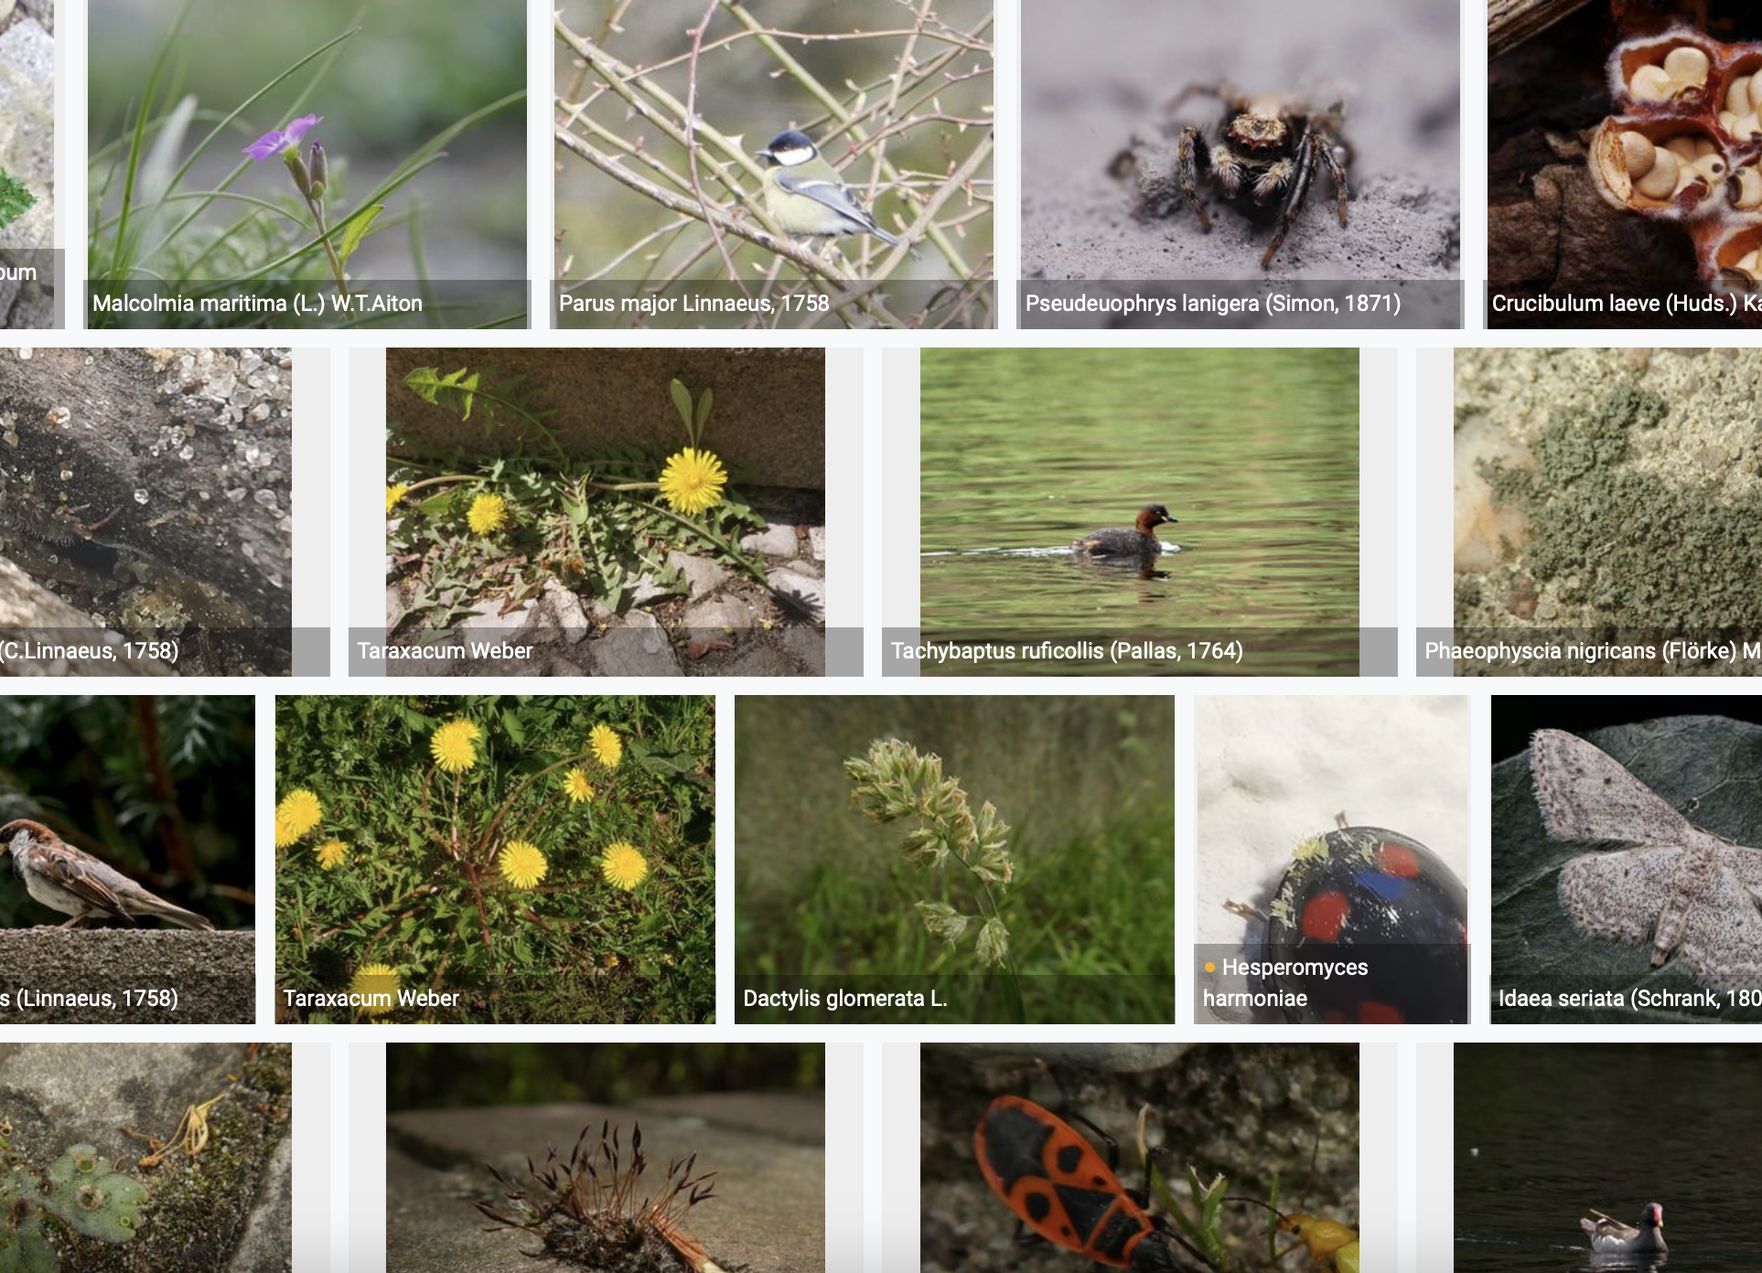
Species occurrence records with multimedia evidence: 2023
2 October 2023
146.1 million records with taxonomically identified images
97.4 million human observations
52.7 million specimens
1.1 million material samples
1.1 million fossil specimens
1,217,664 audio files
3,758 videos
https://www.gbif.org/occurrence/gallery

Slide 4
GBIF Participant countries
1 Oct 2023
Voting Participants
Associate Participants
Notes:
This map is fully editable. This map is a grouped element of all the countries in the world. All the countries are named correctly and can be accessed and selected via the Selection Pane.
There are ways you can edit and make changes to the map. But please remember to always make a copy of the map on your slide and never make changes to the toolkit version.
Please take a look at the next few slides to find out different ways of editing this map

Slide 5
GBIF network of data publishing institutions
1 Oct 2023
139
countries/areas with institutions
sharing data through GBIF
Number of active publishers by country or area - 2 Oct 2023

Slide 6
GBIF.org traffic by country: 2023
30 June 2023
Rank | Country/Territory | Visitors | Visits | Effective visits* | % Effective visits | 2022 rank | Pages / visit
1 | United States | 589,879 | 699,992 | 286,997 | 11.22% | 1 | 4.52
2 | Colombia | 261,310 | 334,997 | 150,749 | 5.89% | 2 | 4.31
3 | Brazil | 230,492 | 274,758 | 126,389 | 4.94% | 4 | 4.41
4 | Mexico | 248,159 | 295,591 | 121,163 | 4.74% | 5 | 4.26
5 | France | 236,813 | 281,251 | 112,500 | 4.40% | 9 | 4.37
6 | China | 136,765 | 193,078 | 111,985 | 4.38% | 3 | 10.44
7 | Spain | 176,936 | 225,329 | 110,411 | 4.32% | 6 | 6.12
8 | Germany | 203,113 | 247,598 | 93,511 | 4.16% | 10 | 5.57
9 | Indonesia | 131,291 | 164,054 | 83,304 | 3.65% | 7 | 6.00
10 | India | 199,463 | 225,145 | 80,471 | 3.26% | 11 | 3.58
 | TOTAL | 4,615,229 | 5,686,046 | 2,558,721 | 100.00% |  | 5.40

Slide 7
Occurrences published by country: 2023
30 Sept 2023
Rank | Country/Territory | 2023 | 2022 total | 2022 rank
1 | United States | 146,409,048 | 123,152,046 | 1
2 | Canada | 22,356,855 | 22,328,115 | 4
3 | France | 13,179,556 | 40,243,552 | 2
4 | Netherlands | 10,861,606 | 30,330,743 | 3
5 | India | 8,537,221 | 7,300,428 | 9
6 | United Kingdom | 8,052,202 | 14,602,384 | 6
7 | Sweden | 7,728,296 | 13,698,583 | 7
8 | Spain | 6,784,103 | 5,058,667 | 13
9 | Colombia | 4,492,587 | 6,052,455 | 12
10 | Chile | 4,457,902 | 907,724 | 30
OTHER COUNTRIES + AREAS | OTHER COUNTRIES + AREAS | 75,775,067 | 66,653,115
TOTAL |  | 308,634,443 | 369,598,387
Notes:
This is a live doughnut pie chart representing different theme colours and how they work, placed next to one another.
You do not have to use the same exact chart, you can simply create your own by clicking on:
Insert tap on the ribbon > Click on Chart > chose a chart of your choice (in this example I chose, Doughnut) > add in your data in the automatically opened Excel sheet and see your chart changing and adopting to the new information you have entered in the data sheet.

Slide 8
Data download requests by country: 2023
30 Sept 2023
Rank | Country |  | 2023 | 2022 total | 2022 rank
1 | China | 33,928 |  | 36,844 | 1
2 | United States | 26,721 |  | 24,812 | 3
3 | Mexico | 18,797 |  | 27,172 | 2
4 | Colombia | 14,253 |  | 18,392 | 4
5 | Brazil | 14,227 |  | 14,777 | 5
6 | Spain | 10,754 |  | 9,280 | 7
7 | United Kingdom | 7,426 |  | 10,256 | 6
8 | France | 6,394 |  | 5,231 | 9
9 | Germany | 5,014 |  | 4,590 | 11
10 | Canada | 4,796 |  | 4,782 | 10
OTHER COUNTRIES + AREAS | ALL OTHERS | 69,224 |  | 75,107
TOTAL |  | 211,534 |  | 232,591
157
countries, islands & territories where users have ≥5 requested downloads
Notes:
NB: 2023 totals account for multiple recurrent downloads by scripts and bots that are discarded, accounting for (in Oct 2023):
Argentina: 2,099
Bangladesh: 1,031
Belgium: 3,146
China: 51,149
Denmark: 13,887
Finland: 1,043
France: 8,692
Greece: 1,380
Guatemala: 1,690
Hong Kong: 2,731
India: 3,579
Italy: 5,131
Japan: 176,108
Mexico: 4,155
Netherlands: 1,884
Norway: 14,109
Switzerland: 3,666
Ukraine: 1,931
United States: 7,124

Slide 9
Peer-reviewed publications using GBIF-mediated data
30 Sept 2023
Notes:
The next 3 slides are showcasing PPT standard or Live charts.
To create a chart simply click on the Insert tap on the ribbon > Click on Chart > chose a chart of your choice (in this example I chose, Bar) > add in your data in the automatically opened Excel sheet and see your chart changing and adopting to the new information you have entered in the data sheet.

Slide 10
Data use in peer-reviewed journals: 2023
30 Sept 2023
Peer-reviewed uses by country
Peer-reviewed uses by region
End of Year |  |  | 2023 total | 2022 total | 2022 rank
1 | United States |  | 281 | 306 | 2
2 | China |  | 276 | 309 | 1
3 | Brazil |  | 133 | 167 | 3
3 | United Kingdom |  | 133 | 149 | 4
5 | Germany |  | 121 | 126 | 6
6 | Mexico |  | 91 | 146 | 5
7 | Spain |  | 89 | 105 | 9
8 | France |  | 79 | 78 | 7
9 | Australia |  | 76 | 78 | 7
10 | India |  | 60 | 63 | 12

Slide 11
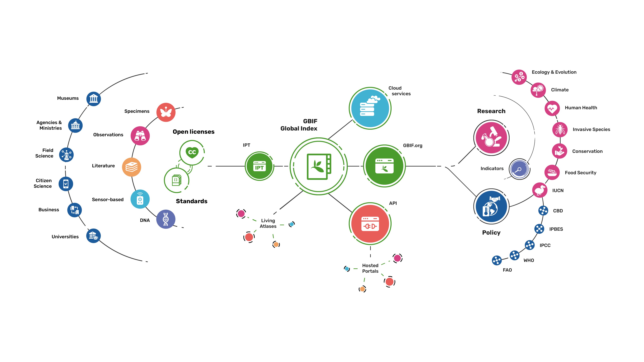
Providing biodiversity evidence for research and policy

Slide 12
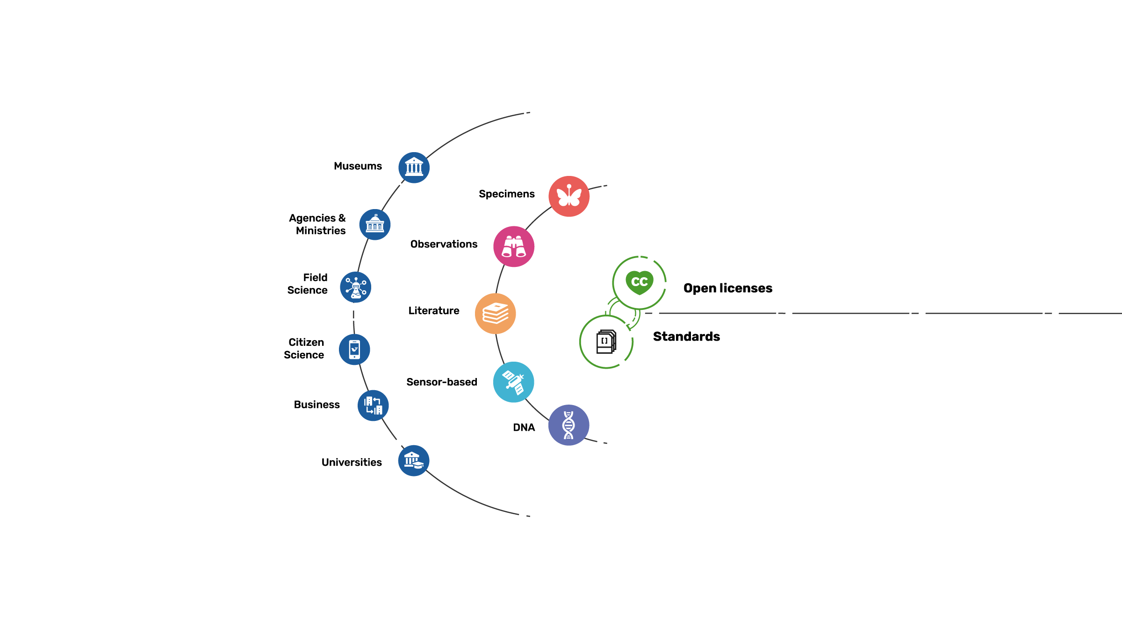
Sources of biodiversity evidence
Create
Combine sources of evidence

Slide 13
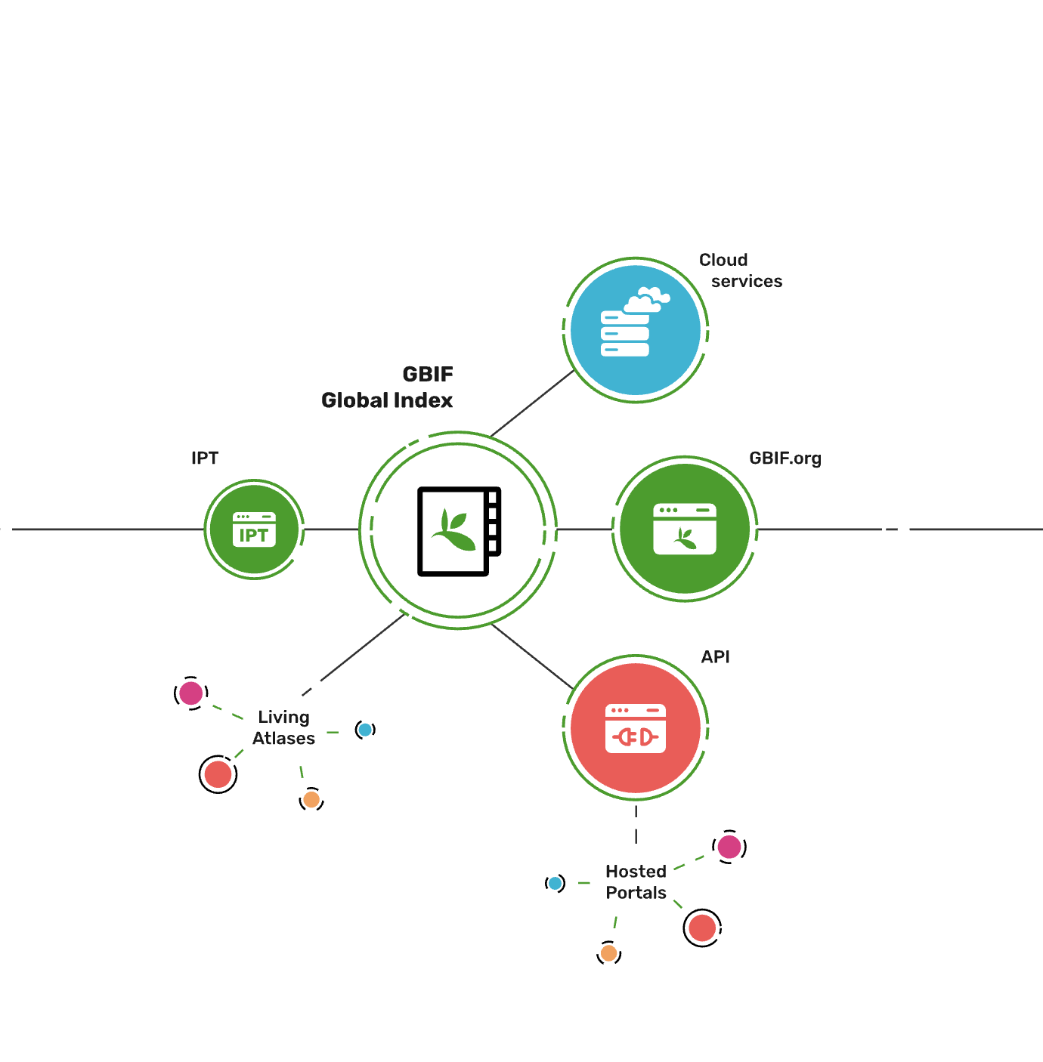
Access to biodiversity evidence
Share
FAIR and open access

Slide 14
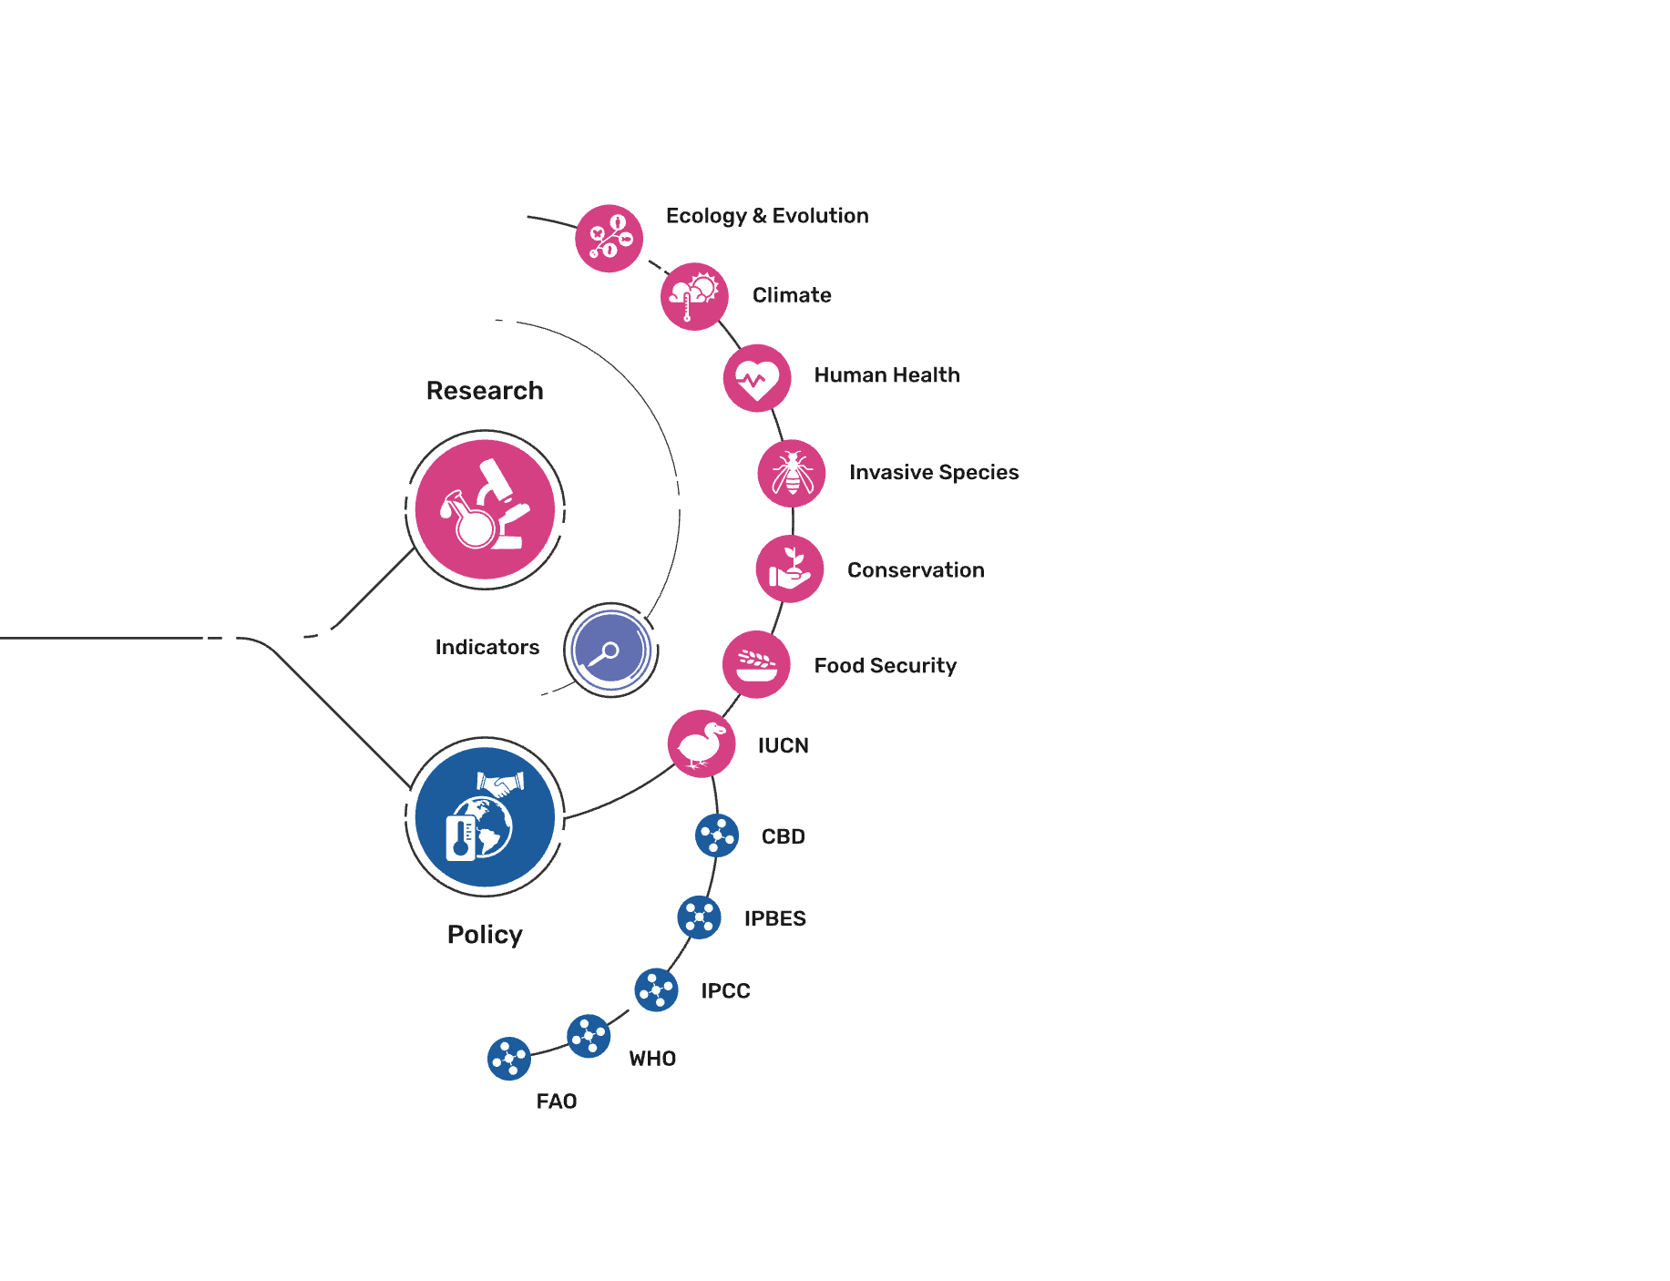
Uses of biodiversity evidence
Transform
Apply and use data

